Slide 1

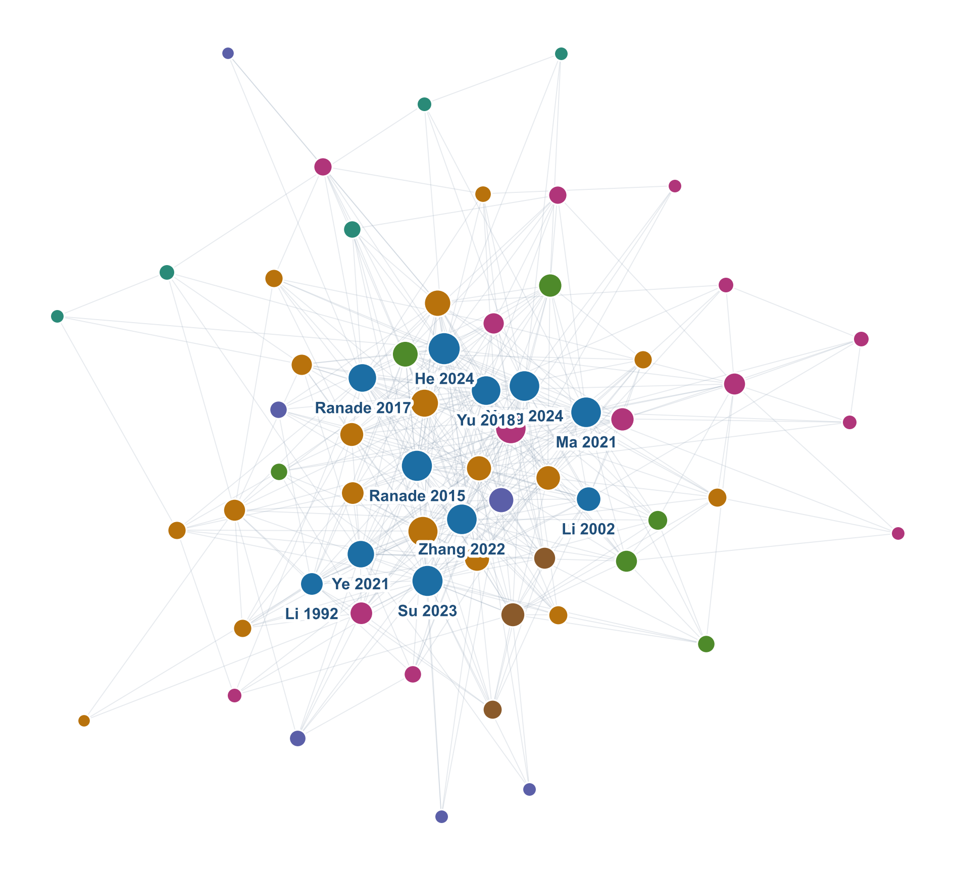
BUILDING AN LLM WIKI FOR HIGH DUCTILE CONCRETE
Advisor: Prof. [Advisor name]
Master’s Student: [Your name]
Project 1 · LLM wiki system for a smart concrete
Project 2 · Literature review of high ductile concrete with the wiki
11 papers · 67 linked notes · 885 links
conslmhoang.github.io/HDC-wiki
Department of Architecture and Civil Engineering · [Date]
Notes:
Introduce yourself. One-sentence summary: I built a wiki that an LLM writes and maintains from 11 papers on high ductile concrete, and I used it to write the literature review. The talk has two parts: 20 minutes on the system, 35 minutes on the review, then questions.

Slide 2

Two projects, one system
Overview
Department: Architecture and Civil Engineering
Course: Smart Concrete
Part A · 20 min
Part B · 35 min
5 min
Setting up the LLM wiki
Literature review: high ductile concrete
Questions
The idea, the three layers, the rules, the ingest workflow, quality control, publishing, two live demos.
Terminology, design theory, materials, mechanical and dynamic behaviour, durability, applications, gaps.
Agenda
Chonnam National University
Page 2
Notes:
Project 1 asked for an LLM wiki system on one smart-concrete topic; Project 2 asked for a literature review written with that system. I chose high ductile concrete. Part A shows how the system works; Part B is the review itself, and every claim in Part B comes from the wiki with a citation.

Slide 3
Setting up the LLM wiki
Part A: LLM wiki setup
Department: Architecture and Civil Engineering
Course: Smart Concrete
Part A
Instead of asking an LLM to search papers every time, let it write and maintain a knowledge base once.
Chonnam National University
Page 3
Notes:
Part A, about 20 minutes. The core idea comes from Andrej Karpathy’s “LLM wiki” proposal: the model compiles knowledge into linked notes rather than re-reading raw sources for every question.

Slide 4
1.1. A literature review is a synthesis problem
Part A: LLM wiki setup
Department: Architecture and Civil Engineering
Course: Smart Concrete
Search-and-answer (RAG)
Compiled wiki
Retrieves a few text chunks per question
Re-derives the answer from scratch every time
Nothing accumulates between questions
Weak at “compare 11 papers on one property”
Each paper is read once, in full
Knowledge goes into linked topic notes
Every new paper updates the existing notes
Conflicts and gaps are recorded as they appear
Part A · Why a wiki
Chonnam National University
Page 4
Notes:
The difference is when the thinking happens. RAG thinks at question time and forgets. The wiki thinks at ingest time and keeps the result, so the cross-paper comparison is already written when I need it for the review.

Slide 5


1.2. Three layers, three owners
Part A: LLM wiki setup
Department: Architecture and Civil Engineering
Course: Smart Concrete
wiki/ · owned by the LLM
raw/ · owned by me
CLAUDE.md · agreed together
Wiki
Raw sources
Schema
67 Markdown notes with 885 links: one per paper, plus concepts, materials, properties, tests, applications and data tables.
11 PDF papers. Read-only: never edited, renamed or deleted by the LLM.
The rules the LLM must follow: structure, units, citations, conflict handling.
The human curates sources and checks results. The LLM does the reading, summarising, cross-linking and bookkeeping that people usually abandon.
Part A · Architecture
Chonnam National University
Page 5
Notes:
Raw sources are the ground truth and are never touched. The wiki is entirely written by the LLM. The schema is the contract between us: I edit it only when we agree on a convention change, for example when I asked for batch ingest. Tool used: Claude Code working directly on the folder, with Obsidian to browse it.

Slide 6
1.3. The wiki is just a folder of linked notes
Part A: LLM wiki setup
Department: Architecture and Civil Engineering
Course: Smart Concrete
wiki/
├─ index.md · catalogue, read first
├─ log.md · every operation
├─ gaps.md · conflicts, open questions
├─ sources/ · 11, one per paper
├─ concepts/ · 18
├─ materials/ · 6
├─ properties/ · 14
├─ test-methods/ · 6
├─ applications/ · 5
├─ datasets/ · 3 master tables
└─ synthesis/ · review outline
Plain Markdown
Readable in any editor, versioned with Git, no database.
Wikilinks
[[pva-fiber]] style links. Every page links in and out.
Templates
Each source note has the same fields: mix design, test methods, results with table location, limitations, items to verify.
Part A · Structure
Chonnam National University
Page 6
Notes:
Point out that this is deliberately low-tech. Obsidian opens the folder and draws the graph; GitHub stores the history. Datasets are three master tables: mix designs, mechanical results and micromechanical parameters, which is where the figures in Part B come from.

Slide 7
1.4. Evidence rules keep the LLM honest
Part A: LLM wiki setup
Department: Architecture and Civil Engineering
Course: Smart Concrete
Every number is cited
Never invent
Source note plus table, figure or page, so any value can be checked in the PDF in seconds.
No made-up numbers, authors or DOIs. Doubtful items get ⚠ and a “to verify” entry.
Reported vs interpreted
Keep both sides of a conflict
The LLM’s own cross-paper reasoning is marked “Synthesis”, separate from what papers state.
Disagreeing values are never averaged. Both stay, and the conflict goes on the gaps page.
Part A · Schema rules (CLAUDE.md §4)
Chonnam National University
Page 7
Notes:
This is the most important part of the setup. Without these rules an LLM will happily average two numbers or fill a missing DOI from memory. A fifth rule, not shown: background knowledge without a source must be tagged “general knowledge — needs source”. Units are also fixed in the schema: MPa, %, µm, vol.%.

Slide 8
1.5. Four operations run the wiki
Part A: LLM wiki setup
Department: Architecture and Civil Engineering
Course: Smart Concrete
1 · Ingest
2 · Integrate
3 · Lint
4 · Query and draft
ingest new
(automatic)
lint
draft chapter 5
Find unread PDFs, read each in full, write its source note.
Update 5–15 topic notes and the data tables; log conflicts.
Broken links, orphan pages, uncited claims, missing topics.
Answers and review prose that cite source notes only.
Each operation is defined in the schema, so the same command gives the same procedure in every session.
Part A · Workflow
Chonnam National University
Page 8
Notes:
I only type short commands. “ingest new” compares raw/ with the source notes, so I can drop many PDFs in at once. For the last batch of five papers, five sub-agents drafted the source notes in parallel, then one agent integrated them one at a time to keep the topic notes consistent.

Slide 9
1.6. What one paper turns into
Part A: LLM wiki setup
Department: Architecture and Civil Engineering
Course: Smart Concrete
Example: Li et al. 2002, PVA-ECC interface tailoring
12
11
The source note holds
topic notes updated or created
rows added to the data tables
Bibliography, material term used by the authors
Mix design and fiber properties
Test methods, curing and age
Results with table and figure numbers
Mechanisms, limitations, relation to other papers
A checklist of items to verify
2
8
conflicts or refinements logged
items flagged for me to verify
Part A · One ingest · source: wiki/log.md
Chonnam National University
Page 9
Notes:
This is the compounding effect. A single paper on PVA fibers changed the PVA, interface, strain-hardening, crack-width and tensile-strain pages, filled the biggest gap in the wiki (no normal-strength PVA source), and refined an earlier value: slip hardening β of 1.15–2.31 instead of the 0.6 quoted second-hand.

Slide 10
1.7. From 11 papers to a connected knowledge base
Part A: LLM wiki setup
Department: Architecture and Civil Engineering
Course: Smart Concrete
11
67
885
44
14
papers read in full
wiki notes
links between notes
rows of mechanical results
conflicts between papers logged
Part A · Scale · counts from the site build, 16 Oct 2026
Chonnam National University
Page 10
Notes:
Counts come from build_site.py and the dataset pages. The conflicts number is the one I want to stress: a reviewer would normally miss most of these because they sit in different papers.

Slide 11
1.8. What the checks actually caught
Part A: LLM wiki setup
Department: Architecture and Civil Engineering
Course: Smart Concrete
Errors inside a paper
Conflicts between papers
Terminology traps
Tables that disagree
Same mix, different results
One name, three materials
Ye et al. 2021 list beam depths 40/70/100 mm in one table and 40/100/150 mm in another. Back-calculating strength from peak load supports 40/100/150.
“HSHDC” means a 166 MPa heat-cured composite in Michigan and roughly 100 MPa ambient-cured ones in Xi’an and Guangzhou.
Michigan HSHDC: 3.4% strain capacity in one paper, 4.2% in another, at almost the same loading rate. The review reports the range.
Every flagged item lands on the gaps page or in a source note’s “to verify” list, for me to check against the PDF.
Part A · Quality control · sources: ye2021, ranade2015, ranade2017, yang2024, su2023
Chonnam National University
Page 11
Notes:
Other catches: text extraction turns the micro sign into “m” (28 µm printed as 28 mm), which the LLM checks by rendering the page image; a mis-citation between two reviews about freeze–thaw. The human still verifies: the LLM flags, I decide.

Slide 12

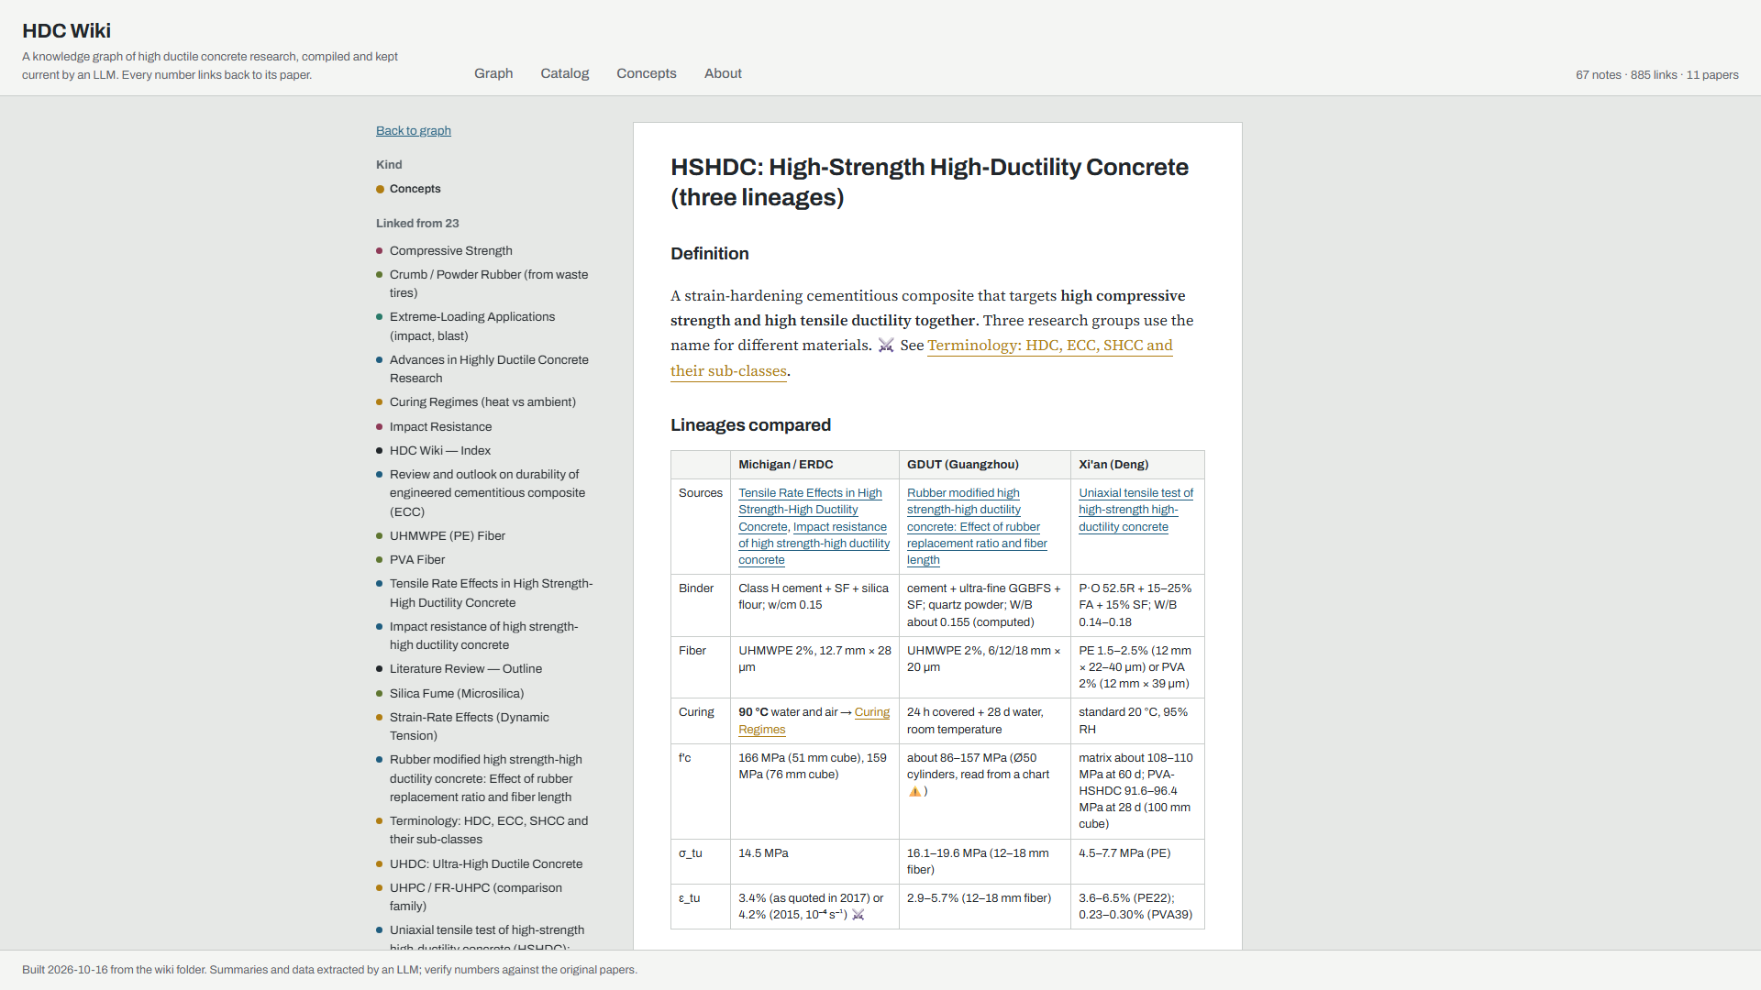
1.9. Publishing: one script, one push
Part A: LLM wiki setup
Department: Architecture and Civil Engineering
Course: Smart Concrete
wiki/*.md
build_site.py
docs/index.html
GitHub Pages
Graph, Catalog, Concepts and About views
Every note readable, links clickable
Rebuilt after each ingest
PDFs never uploaded (copyright)
conslmhoang.github.io/HDC-wiki
Part A · Publishing · github.com/conslmhoang/HDC-wiki
Chonnam National University
Page 12
Notes:
The site is a single static page generated from the Markdown. Git keeps the full history, so every change the LLM made is reviewable as a commit. The .gitignore excludes raw PDFs; only my notes and summaries are public.

Slide 13
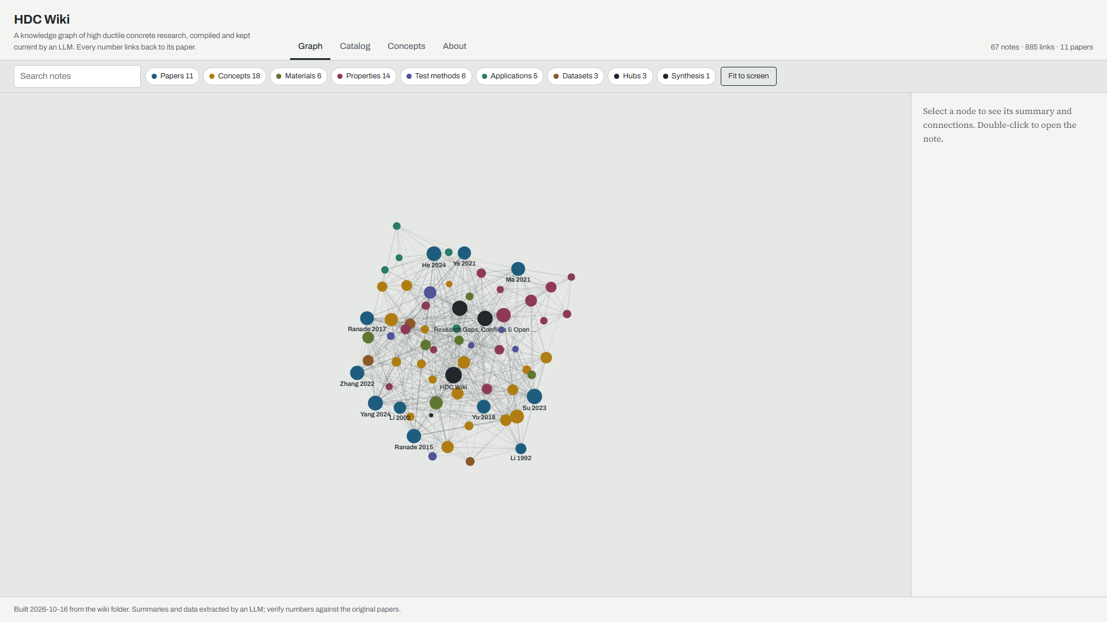
1.10. Live demo 1: exploring the graph
Part A: LLM wiki setup
Department: Architecture and Civil Engineering
Course: Smart Concrete
What I will show
Filter to papers only
Select Li 2002: its 12 linked notes light up
Open the PVA fiber note
Catalog view with DOIs
Backup: this screenshot, if the network fails.
Part A · Demo · conslmhoang.github.io/HDC-wiki
Chonnam National University
Page 13
Notes:
Switch to the browser. Colour shows note type: papers in steel blue, concepts in ochre, properties in plum. Node size is the number of links. Double-click a node to open its note. Keep the demo under three minutes.

Slide 14
1.11. Live demo 2: asking the wiki a question
Part A: LLM wiki setup
Department: Architecture and Civil Engineering
Course: Smart Concrete
Why does PVA fiber work in ECC but fail in high-strength HDC?
PVA is hydrophilic and bonds chemically, so untreated fibers rupture. Oil coating lowers the bond and raises strain capacity from 0.99% to 4.88%. [li2002, Table 4]
In a dense W/B 0.16 matrix, PVA-HSHDC reaches only 0.23–0.30%, while PE reaches up to 6.48%. [yang2024, Table 6]
Reviews of high-strength composites call PE fiber “mandatory” because PVA bonds too strongly. [zhang2022, p. 4, 16]
Backup answer above. Live: the same question typed into Claude Code; it reads index.md, then the PVA, interface and HSHDC notes.
Part A · Demo · query operation (CLAUDE.md §5.2)
Chonnam National University
Page 14
Notes:
The point of this demo is that the answer is short, cross-paper, and every sentence carries a source note and location. If the answer is reusable, the schema says the LLM should offer to save it as a synthesis page, so the next question starts from it.

Slide 15
1.12. What worked, and what still needs a human
Part A: LLM wiki setup
Department: Architecture and Civil Engineering
Course: Smart Concrete
Worked well
Needs a human
Knowledge compounds: each paper improves old notes
Conflicts surface automatically
Uniform structure across every paper
Batch ingest with parallel agents
Git history makes every change auditable
Values read off figures are approximate
Review papers give second-hand data, marked “as cited”
Choosing and scoping the sources
Checking every number that goes on a slide
Copyright: summaries public, PDFs private
Part A · Lessons
Chonnam National University
Page 15
Notes:
Be honest about limits. The corpus is 11 papers and several come from the same research groups. The wiki makes that visible on the gaps page instead of hiding it. That is the bridge to Part B.

Slide 16
Literature review: high ductile concrete
Part B: Literature review
Department: Architecture and Civil Engineering
Course: Smart Concrete
Part B
A concrete that bends instead of breaking: what it is, why it works, and what we still do not know.
Chonnam National University
Page 16
Notes:
Part B, about 35 minutes. Everything that follows comes from the wiki pages; the source tags in each footer point to the source notes, which point to tables and pages in the PDFs.

Slide 17
2.1. The corpus: 11 papers, 1992–2024
Part B: Literature review
Department: Architecture and Civil Engineering
Course: Smart Concrete
Year | Authors | Journal | Role in the review
1992 | Li & Leung | J. Eng. Mech. (ASCE) | Theory: steady-state cracking
2002 | Li et al. | ACI Materials Journal | PVA-ECC interface tailoring
2015 | Ranade, Li, Heard | Cem. Concr. Res. | HSHDC under dynamic tension
2017 | Ranade et al. | Cem. Concr. Res. | HSHDC slabs under impact
2018 | Yu et al. | Constr. Build. Mater. | Review: direct tensile properties
2021 | Ma et al. | Constr. Build. Mater. | Review: durability of ECC
2021 | Ye et al. | Cem. Concr. Compos. | UHDC flexural size effect
2022 | Zhang et al. | Composites Part B | Review: high-strength HDC (HSHDCC)
2023 | Su et al. | Constr. Build. Mater. | Rubber-modified HSHDC
2024 | Yang et al. | J. Building Engineering | HSHDC uniaxial tension (Xi’an)
2024 | He et al. | Materials | Review: advances in HDC
Part B · Corpus · shaded rows are review papers (second-hand data)
Chonnam National University
Page 17
Notes:
Seven primary studies and four reviews. The reviews widen coverage, especially for durability and applications, but their numbers are second-hand: in the wiki they are always marked “as cited”. Full references are on the Catalog page of the site.

Slide 18
2.2. HDC, ECC and SHCC are one material family
Part B: Literature review
Department: Architecture and Civil Engineering
Course: Smart Concrete
Chinese papers write “high ductile (or high-ductility) concrete, also known as ECC”. Japan says UHPFRCC, Europe says SHCC. The common definition: tensile strain hardening with multiple fine cracks.
Class | f'c | Tensile strain capacity | Source
Normal ECC / HDC | 30–80 MPa | 2–8% | Su 2023; Zhang 2022
High-strength (HSHDCC) | > 100 MPa | > 3% | Zhang 2022
Ultra-high ductile (UHDC) | about 37 MPa | up to 12% | Ye 2021
UHPC (not HDC) | ≥ 150 MPa | < 1% | Zhang 2022; Ranade 2017
No ingested source cites a formal standard that defines HDC. Thresholds differ between reviews.
Part B · Terminology · wiki: terminology-hdc-ecc-shcc
Chonnam National University
Page 18
Notes:
Key message for the audience: HDC is a regional name, not a separate material. Fiber type does not define it: Chinese groups use both PVA and PE. Thresholds are inconsistent: other reviews use more than 55 MPa and 4%, or more than 80 MPa and 2%. Under Zhang’s cut-off, the Xi’an PVA-HSHDC at about 94 MPa would not count as high-strength.

Slide 19
2.3. Four research lineages in the corpus
Part B: Literature review
Department: Architecture and Civil Engineering
Course: Smart Concrete
 | Michigan / ERDC | GDUT, Guangzhou | Xi’an (Deng) | Tongji (Yu)
Name used | HSHDC | R-HSHDC | HSHDC | UHDC
Binder | Class H cement, silica fume, w/cm 0.15 | cement, slag, silica fume | cement, 15–25% fly ash, W/B 0.16 | cement, fly ash 1.2× cement
Fiber | PE 2%, 28 µm | PE 2%, 20 µm | PE or PVA | PE 1–2%
Curing | 90 °C water and air | room temperature | 20 °C standard | room temperature
f'c | 166 MPa | about 86–157 MPa | about 92–110 MPa | about 37 MPa
Strain capacity | 3.4–4.2% | 2.9–5.7% | PE 3.6–6.5%; PVA 0.2–0.3% | 4.3–9.5%
Part B · Lineages · Ranade 2015, 2017; Su 2023; Yang 2024; Ye 2021 · wiki: hshdc
Chonnam National University
Page 19
Notes:
Always name the lineage when quoting “HSHDC” values. Michigan reaches high strength with heat curing; the Chinese groups use ambient-cured binders with fly ash or slag and finer PE fibers. GDUT f'c values were read from a bar chart, so they are approximate.

Slide 20
2.4. Why it bends: many fine cracks instead of one
Part B: Literature review
Department: Architecture and Civil Engineering
Course: Smart Concrete
The multiple-cracking cycle
The matrix cracks at its largest flaw
Fibers bridging the crack carry the whole load
They pass load back into the matrix by shear
A new crack forms at the next flaw, at a higher stress
Repeat until one crack’s bridging capacity is exhausted
Li & Leung 1992, Eq. 17
Vf,crit ∝ (Lf / df)⁻³
The critical fiber volume falls with the cube of the aspect ratio: doubling fiber length cuts the fiber needed by 87.5%.
Prerequisite: each crack must open flat, at constant stress (steady-state cracking), not like a Griffith crack.
Energy condition: area under the bridging curve ≥ 10 × crack-tip toughness.
Part B · Design theory · li1992-steady-state-multiple-cracking · wiki: steady-state-cracking
Chonnam National University
Page 20
Notes:
This 1992 paper is the foundation of every later ECC and HDC design. It also adds a flaw-size condition that the later PSH indices leave out, which matters two slides from now. Note: the paper’s Table 1 critical volumes could not be reproduced exactly from Eq. 17, flagged on the source note.

Slide 21
2.5. Two design criteria for strain hardening
Part B: Literature review
Department: Architecture and Civil Engineering
Course: Smart Concrete
Strength criterion
Energy criterion
σfc ≤ min(σ₀)
Jtip ≈ Km²/E ≤ J′b
The first-crack stress must stay below the bridging capacity of the weakest section.
The complementary energy of fiber bridging must exceed the matrix crack-tip toughness, so cracks open flat.
Robust if the ratio > 1.2
Robust if the ratio > 3
Two design levers follow: weaken the matrix (lower Km and σfc) or strengthen the bridging (more, longer, stronger fibers, a tuned interface).
Part B · Design theory · Kanda & Li 1998 as cited in ranade2015, su2023 · wiki: strain-hardening
Chonnam National University
Page 21
Notes:
These are the pseudo strain-hardening (PSH) indices used by every primary study in the corpus. Example: Michigan HSHDC at quasi-static rate has a strength ratio of about 1.8 and an energy ratio of about 39; at 10 per second the energy ratio drops to about 6 but strain hardening survives.

Slide 22
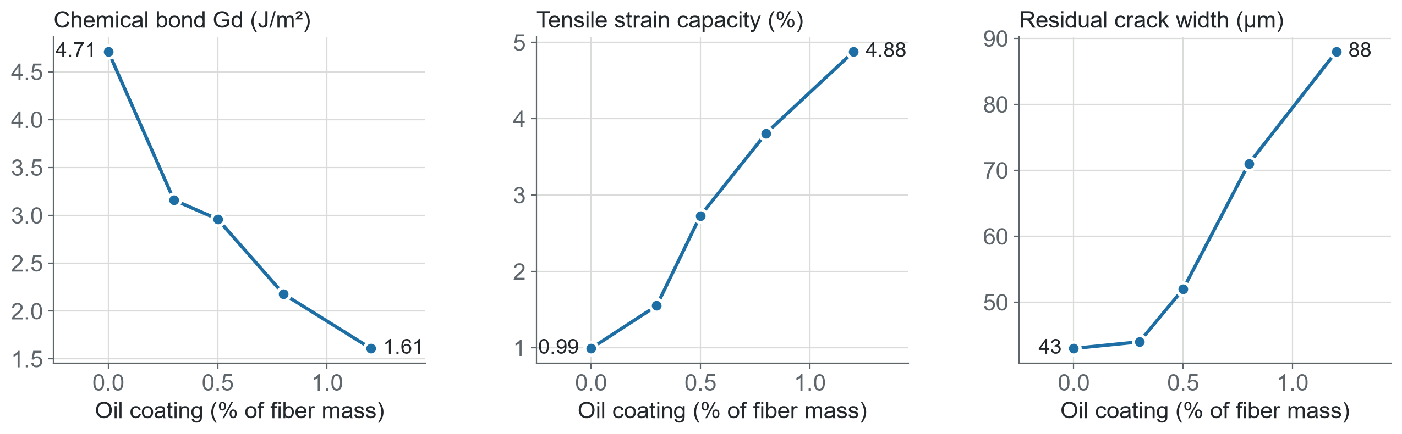
2.6. Tuning the interface: oil-coated PVA
Part B: Literature review
Department: Architecture and Civil Engineering
Course: Smart Concrete
A 100 nm oil coating weakens PVA’s chemical bond. Fibers pull out instead of rupturing, and strain capacity rises fivefold.
Part B · Interface · li2002-pva-ecc-interface-tailoring, Tables 3–4 · wiki: fiber-surface-treatment
Chonnam National University
Page 22
Notes:
The trade-off in the third panel: lower bond means a softer bridging curve, so cracks get wider (43 to 88 micrometres) while still staying under 100. Crack saturation starts at about 0.8% oil, exactly where the energy ratio passes 3. Commercial PVA for ECC uses 0.8–1.2% oil. Matrix: w/c 0.45, no fly ash, 2% PVA, 12 mm by 39 µm.

Slide 23
2.7. The two criteria fail in opposite cases
Part B: Literature review
Department: Architecture and Civil Engineering
Course: Smart Concrete
PVA-ECC · Li et al. 2002
6 mm PE HSHDC · Su et al. 2023
Strength ratio cannot tell them apart
Both criteria pass, yet one crack
σtu/σfc is 1.5–1.8 for every mix, including the brittle 0.99% one. The energy ratio does separate them: saturation starts as it passes 3.
Strength ratio 1.2–1.5 and energy ratio 27–32, above both thresholds. The mixes still fail at the first crack: fibers only 3 mm deep pull out.
Synthesis (my interpretation)
The indices omit embedment length and flaw size, which Li & Leung’s 1992 criteria include. The criteria are necessary, not sufficient.
Part B · Design theory · li2002 Table 4; su2023 Table 5, p. 10; li1992 Eq. 24 · wiki: strain-hardening, gaps
Chonnam National University
Page 23
Notes:
This is one of the findings that only appeared because the wiki put the two papers side by side. It is labelled as synthesis, not as something either paper claims. It is also logged as an open question on the gaps page.

Slide 24
2.8. PVA or PE: the fiber decides the matrix
Part B: Literature review
Department: Architecture and Civil Engineering
Course: Smart Concrete
 | PVA (hydrophilic) | PE / UHMWPE (hydrophobic)
Bond to matrix | chemical + friction | friction only
Tensile strength | about 1600 MPa | 2300–3800 MPa
Modulus | about 40 GPa | 70–120 GPa
Strain capacity, normal matrix | 4.88% (oil-coated) | 9.45% (UHDC)
Strain capacity, high-strength matrix | 0.23–0.30% | up to 6.48%
Typical crack width | about 40–90 µm | about 80–200 µm
Melting point | about 230–270 °C ⚠ | about 124–150 °C
PVA suits moderate-strength ECC once its bond is tamed. In high-strength matrices PE is the only fiber that works.
Part B · Fibers · li2002; yang2024 Tables 3, 6; ye2021; yu2018 Table 2; zhang2022; su2023 · wiki: pe-fiber, pva-fiber
Chonnam National University
Page 24
Notes:
Point at the two strain rows: the same PVA fiber gives almost 5% in a normal matrix and 0.3% in a dense W/B 0.16 matrix, because the dense matrix makes the bond even stronger. PVA melting point values differ between sources, hence the warning mark. The low PE melting point is the price for its strength.

Slide 25
2.9. Mix-design levers for ductility
Part B: Literature review
Department: Architecture and Civil Engineering
Course: Smart Concrete
Lever | Measured effect on strain capacity | Source
Fly ash 15 → 25% | +68.9%, lower first-crack stress | Yang 2024 (Xi’an)
W/B 0.14 / 0.16 / 0.18 | 0.81 / 3.84 / 1.89%: an optimum, not a trend | Yang 2024
PE diameter 40 → 22 µm | 0.35 → 3.84% | Yang 2024
PE length 6 → 18 mm | 9.5× (6 mm stays brittle) | Su 2023 (GDUT)
Powder rubber 20 vol.% | up to +71.6%, f'c still above 100 MPa | Su 2023
Silica fume 0 → 40% | 2.5 → 4.7%, narrower cracks | Lei 2019, as cited in Zhang 2022
90 °C heat curing | not required: ambient mixes reach 3.8–6.5% | Su 2023; Yang 2024
Most levers work the same way: they lower matrix toughness or tune the fiber–matrix bond.
Part B · Mix design · wiki: mix-designs, fly-ash, water-binder-ratio, fiber-geometry, crumb-rubber
Chonnam National University
Page 25
Notes:
Each row is one controlled variable in one study, so effects are not additive across rows. The W/B result is the interesting one: too low and the bond is so strong that fibers rupture; too high and they slip. Rubber works by acting as weak spots that lower matrix toughness, but costs compressive strength.

Slide 26
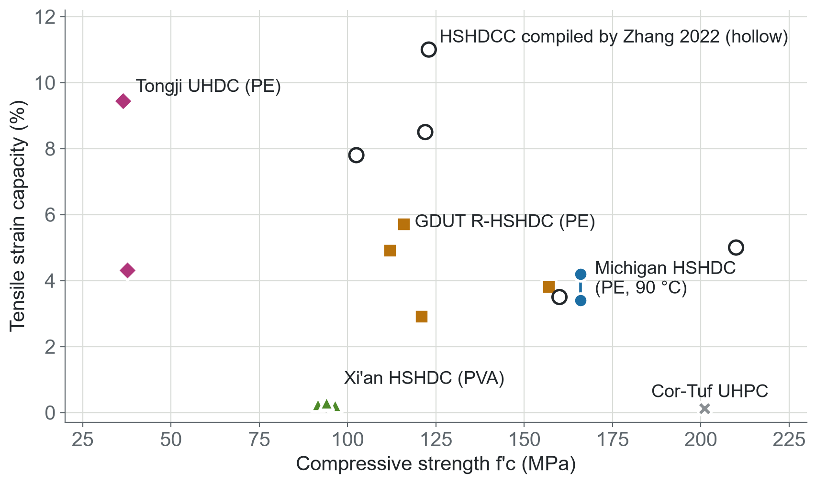
2.10. Strength versus ductility: a trend, not a law
Part B: Literature review
Department: Architecture and Civil Engineering
Course: Smart Concrete
Within the primary studies, ductility falls as strength rises: from 9.45% at 37 MPa to 3.4–4.2% at 166 MPa.
But mixes compiled by Zhang 2022 (hollow) break the trend: more than 5% at over 210 MPa, 8.5% at 122 MPa.
Ductility is set by fiber and interface design, not by f'c alone.
Part B · Tension · wiki: mechanical-results, tensile-strain-capacity · GDUT f'c read from a bar chart (approximate)
Chonnam National University
Page 26
Notes:
This is the key figure of the review. My first version of the wiki concluded there was a fundamental trade-off. When the HSHDCC review was ingested, the wiki logged a conflict and revised the conclusion. Specimens and test setups differ between studies, so read the chart as qualitative. Xi’an PE mixes are not plotted because their composite f'c was not reported.

Slide 27
2.11. The test setup changes the number
Part B: Literature review
Department: Architecture and Civil Engineering
Course: Smart Concrete
Study | Specimen | Gauge | Rate
JSCE (2008) | dogbone, 30 × 13 mm section | 80 mm | —
Li 2002 | coupon 305 × 76 × 13 mm | about 185 mm | 2.5 µm/s
Ranade 2015 | dogbone | 90 mm | 9 µm/s – 0.9 m/s
Su 2023 | JSCE dumbbell | 80 mm | 0.5 mm/min
Yang 2024 | dogbone, 50 × 15 mm section | 150 mm | 0.2 mm/min
Cylinders give lower strength and strain than dogbones; thickness from 13 to 50 mm hardly matters.
Deflection-hardening in bending does not prove tensile strain hardening.
No standard tension test exists for HDC.
Part B · Test methods · yu2018 p. 348–349; zhang2022 p. 9–11; li2002; ranade2015; su2023; yang2024 · wiki: dogbone-uniaxial-tension
Chonnam National University
Page 27
Notes:
Gauge lengths range from 80 to 185 mm and loading rates over orders of magnitude, so strain capacity values from different groups are not strictly comparable. The JSCE dogbone is the most common choice in the HSHDCC literature. The specimen-shape findings are from Kesner 2003, Mechtcherine 2011 and Rokugo 2007, as cited by Yu et al. 2018.

Slide 28
2.12. Enough fiber removes the flexural size effect
Part B: Literature review
Department: Architecture and Civil Engineering
Course: Smart Concrete
Notched beams | Flexural strength | Bažant size-effect law
Plain mortar | 3.7–7.1 MPa | applies
UHDC, 1% PE | 10.0–21.6 MPa | applies
UHDC, 2% PE | 18.3–22.1 MPa | does not apply (D₀ < 0)
UHDC with 2% PE
≈ 20 MPa
nominal flexural strength at every beam depth from 40 to 150 mm and both notch depths (18.3–22.1 MPa)
The fracture process zone grows from under 0.1 mm in mortar to 1.8–24.5 mm in UHDC.
Part B · Size effect · ye2021-uhdc-flexural-size-effect, Tables 3–5 · wiki: size-effect
Chonnam National University
Page 28
Notes:
For designers this is good news: lab-scale flexural strength may transfer to members. But the largest beam was only 150 mm deep; the authors themselves call for metre-scale tests. Note the table inconsistency in this paper on the mortar beam sizes, flagged earlier. The UHDC matrix here is weak (about 37 MPa) and fly-ash rich.

Slide 29
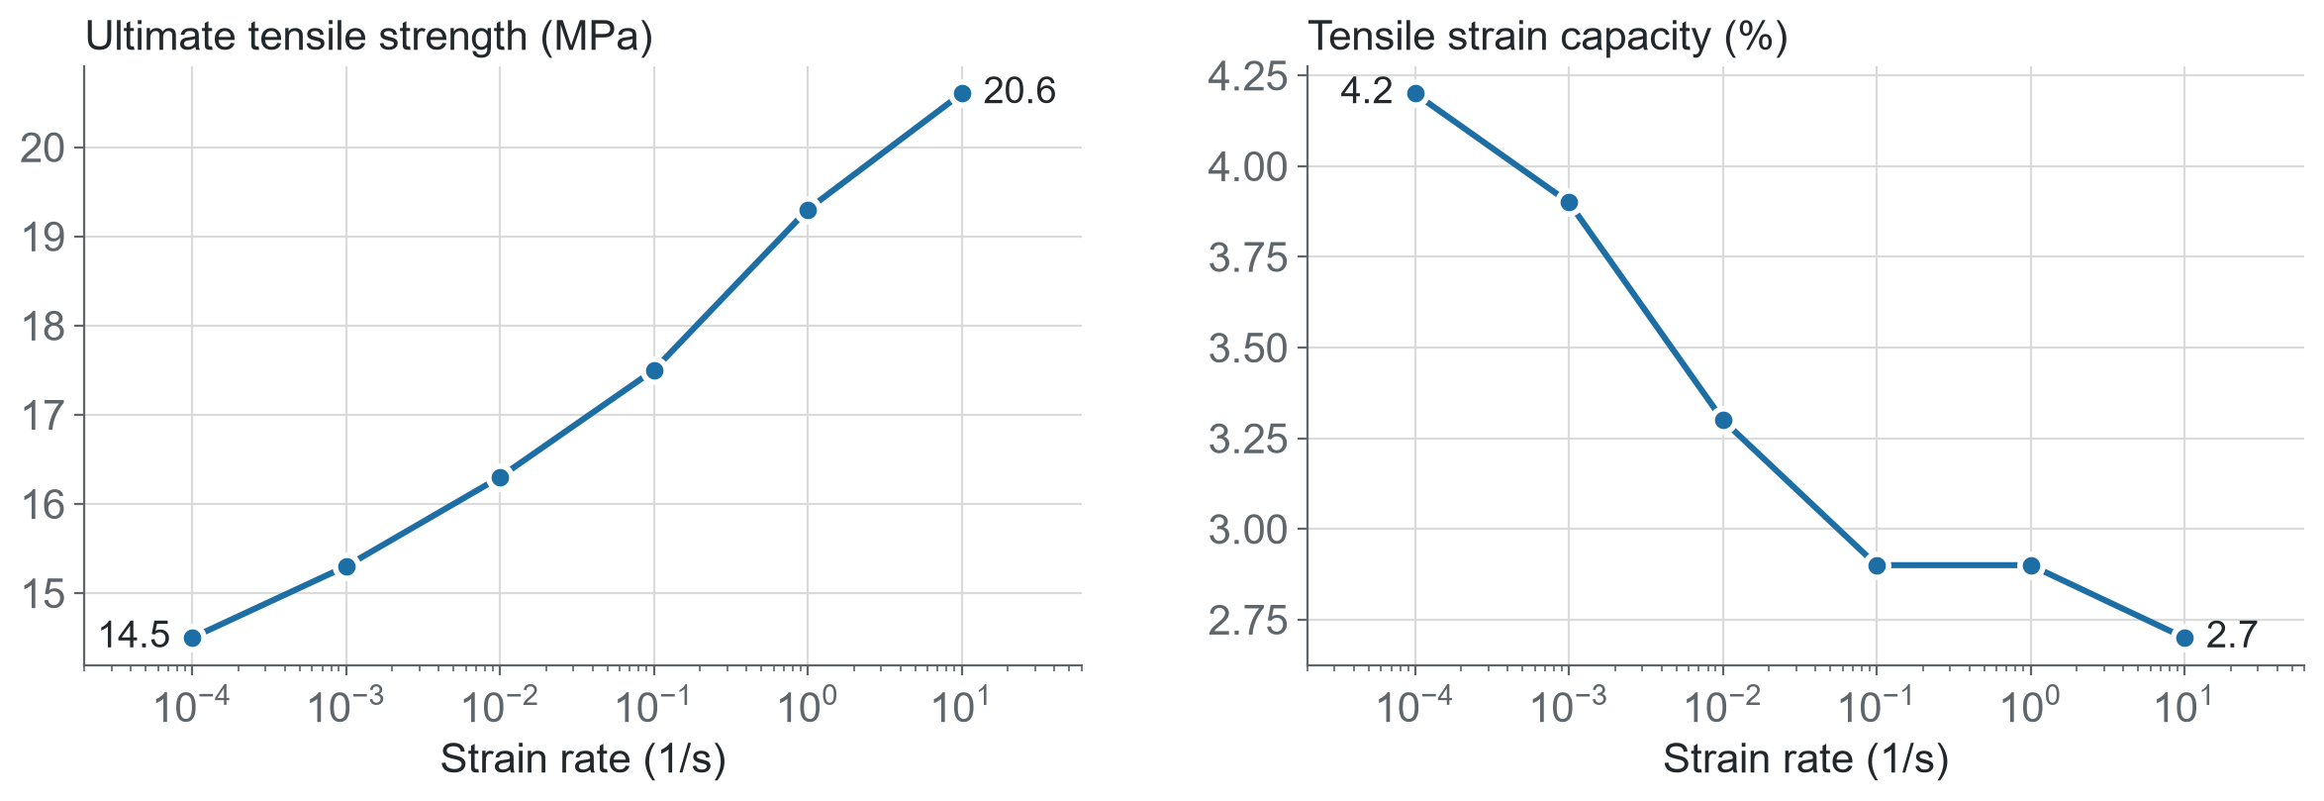
2.13. Under fast loading: stronger, less ductile, still intact
Part B: Literature review
Department: Architecture and Civil Engineering
Course: Smart Concrete
Viscoelastic PE fiber gets 85% stiffer and 21% stronger. Stiffer bridging means narrower cracks (160 → 110 µm), so lower strain.
HSHDC slabs
Cor-Tuf UHPC slabs (201 MPa)
Survived 20 drop-weight impacts at up to 4.6 m/s: fine radial cracks, no punching, almost no spalling.
Failed in flexure at 3.25 and 4.6 m/s, and by punching with the 50 mm head.
Part B · Dynamic · ranade2015 Table 2; ranade2017 Tables 3–4 · wiki: strain-rate-effects, impact-resistance
Chonnam National University
Page 29
Notes:
Two Michigan papers. The interface barely changes with rate because PE has no chemical bond; the fiber itself drives the rate effect. The impact message: first-impact peak force is similar for both materials, but damage tolerance under repeated impact comes from tensile ductility, not compressive strength. Rates above 10 per second, typical of blast, are untested.

Slide 30
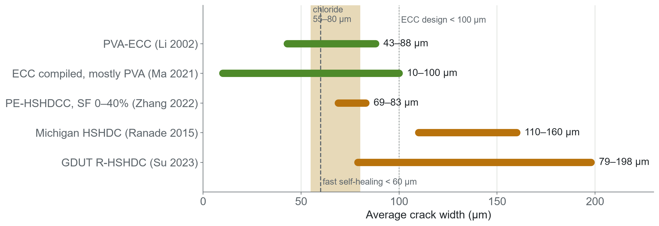
2.14. Two crack-width families, one durability problem
Part B: Literature review
Department: Architecture and Civil Engineering
Course: Smart Concrete
PVA-ECC keeps cracks under the durability thresholds. PE-based HSHDC mostly does not.
Part B · Cracking · li2002; ma2021; zhang2022; ranade2015; su2023; thresholds from ma2021 and he2024 (as cited) · wiki: crack-width
Chonnam National University
Page 30
Notes:
Green bars are PVA-based, orange bars PE-based. Thresholds come from reviews and measure different things: chloride ingress, self-healing speed, the ECC design target. The PE fiber’s lack of chemical bond is what makes cracks wider. Silica fume, rubber, longer fibers or hybrid steel all narrow them, so this is a design target, not a dead end.

Slide 31
2.15. Durability: strong for ECC, unknown for HSHDC
Part B: Literature review
Department: Architecture and Civil Engineering
Course: Smart Concrete
Exposure | Reported finding (normal ECC) | Original study
Freeze–thaw | durability factor above 100, versus 20 for non-air-entrained concrete | Li 2008
Water | cracked at 3% strain: 7.7 × 10⁻¹⁰ m/s, about 10⁻¹² per crack | Lepech & Li 2009
Self-healing | cracks under 60 µm seal in 3–4 days; over 100 µm, 7–10 days or more | as cited, Ma 2021
Shrinkage | 1200–1800 µε at 28 d, versus 400–800 µε for concrete | Yang 2007
Heat (PE-ECC) | strain 9.1% at 20 °C, 1.6% at 140 °C, 0.02% at 200 °C | Luo 2019
Ageing | ductility and self-healing fall as pozzolanic reaction continues | as cited, Ma 2021
All second-hand, through reviews. No ingested study tests the durability of any HSHDC or UHDC.
Part B · Durability · all as cited in ma2021-ecc-durability-review; also he2024 · wiki: durability, self-healing, high-temperature-behaviour
Chonnam National University
Page 31
Notes:
Ma et al. say almost all durability data are at 28 days, and that high-strength and ultra-high-ductility ECC lack durability data. Fire is the clearest weakness: PE melts around 124–150 °C, and PE-ECC loses strain hardening between 100 and 140 °C. PVA-ECC keeps some hardening to about 150–200 °C.

Slide 32
2.16. Where HDC is being used
Part B: Literature review
Department: Architecture and Civil Engineering
Course: Smart Concrete
Masonry retrofit
RC strengthening
Unreinforced structures
PVA-HDC overlay on a half-scale two-storey building beat welded-wire mesh in shake-table tests.
Jacketing of short columns; textile-reinforced HDC for beams and slabs.
Steel-free UHDC frames and a pavilion at the 2021 China Flora Expo.
3D printing
Impact protection
Field use
Printed UHDC performs best at 1.5% PE; layer anisotropy is the open issue.
HSHDC slabs under repeated impact: the only primary structural test in the corpus.
No field deployment of high-strength HDC reported yet.
Part B · Applications · as cited in he2024 (p. 4–9, 19–20); ranade2017; zhang2022 p. 2 · wiki: applications
Chonnam National University
Page 32
Notes:
Be clear that five of these six come from one review paper, so they are second-hand. The primary source to read next would be Deng et al. 2019, Engineering Structures 197, on the masonry shake-table test. This is a limit of my corpus and is listed on the gaps page.

Slide 33
2.17. Research gaps
Part B: Literature review
Department: Architecture and Civil Engineering
Course: Smart Concrete
Durability of high-strength HDC
Fire
No data for HSHDC or UHDC; PE crack widths exceed chloride and self-healing thresholds.
PE-ECC loses strain hardening between 100 and 140 °C; no fire design data.
Standards
Design criteria
No agreed definition of HDC and no standard tension or flexure test.
PSH indices miss embedment length and flaw size, so they can pass brittle mixes.
Structural scale
Time and rate
Size effect tested only up to 150 mm; bond to old concrete unstudied; no field use.
Almost all data at 28 days; nothing above 10 s⁻¹ for HSHDC.
Part B · Gaps · wiki: gaps (14 logged conflicts) · ma2021; zhang2022; yu2018; ye2021; yang2024; su2023
Chonnam National University
Page 33
Notes:
Colour groups: orange for material durability, blue for theory and standards, green for structural and long-term behaviour. All six are on the wiki’s gaps page with the sources behind them. A seventh, about my own corpus: no primary Chinese PVA-HDC study is included yet.

Slide 34
2.18. Conclusions
Part B: Literature review
Department: Architecture and Civil Engineering
Course: Smart Concrete
One family, many names
Ductility is designed at the interface
HDC, ECC and SHCC are defined by tensile strain hardening, not by name or fiber type.
Oil-coated PVA in normal matrices, PE in high-strength ones.
Strength and ductility can coexist
The wiki made the gaps visible
Over 210 MPa with over 5% strain is reported; wider cracks and low heat resistance are the price of PE.
Every claim is traceable to a table or page, and every conflict is logged rather than smoothed over.
Conclusions · full evidence at conslmhoang.github.io/HDC-wiki
Chonnam National University
Page 34
Notes:
Close Part B with the four messages. The first three are about the material; the last ties back to Part A: the method is what let a small corpus produce a review with explicit, checkable gaps.

Slide 35
Questions
Discussion
Department: Architecture and Civil Engineering
Course: Smart Concrete
Wiki: conslmhoang.github.io/HDC-wiki
Code and notes: github.com/conslmhoang/HDC-wiki
Ask about any number: I can open its source note and the table it came from.
Chonnam National University
Page 35
Notes:
Likely questions: How do you know the LLM did not invent numbers? (evidence rules, page images, to-verify lists, my checks). Why only 11 papers? (scope and time; the gaps page states the limits). Can the system scale? (yes, ingest new is batch; the professor’s wiki has about 860 papers). What would you add next? (primary Chinese PVA-HDC and durability studies of HSHDC).

